Slide 1
ECOMMERCE APPLICATION
USING JAVA FULL STACK WEB DEVELOPMENT

Slide 2
CONTENTS
Introduction
Problem Statement
Architecture
Tech Stack
Code Coverage Report

Slide 3
INTRODUCTION
Abhinav Vooba
From NIT Rourkela
Warehouse Management Systems Intern

Slide 4
Problem statement

Slide 5
BlueYonder wants to venture into e-commerce business. BlueYonder wants to quickly develop a MVP (Minimum Viable Product) with some key features in cutting edge technology to demonstrate the capabilities to the investors and stakeholders to get the funding.
Below are the key features to be developed in the first release.
- User Registration and Login
- Product Catalogue Management
- Category Catalogue Management
- Linking Product to Category
- Shopping Cart (Optional)
Design and develop the application in Microservices Architecture with support to access from multiple devices with responsive UI and secure the app with JWT tokens and run the application as containers with 80% automated test coverage.

Slide 6
Ecomapp architecture

Slide 7
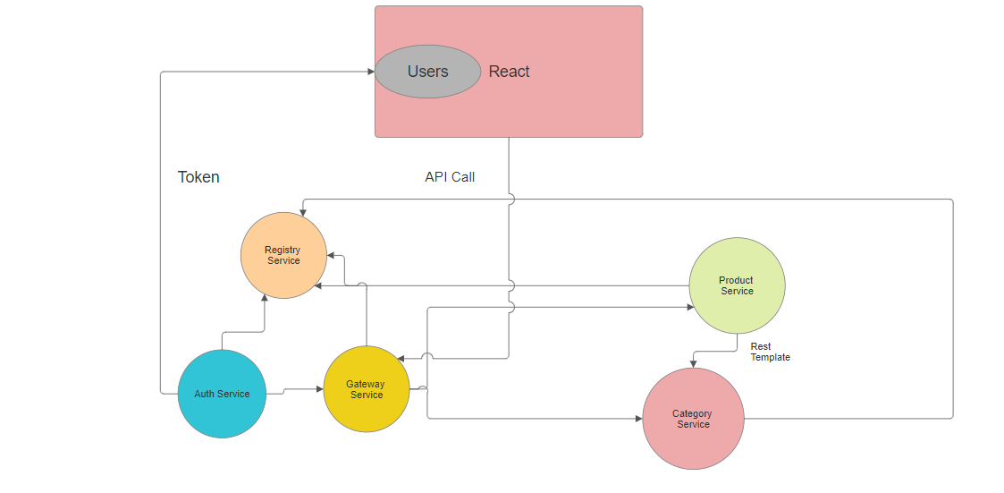

Slide 8
Tech stack
In Ecommerce Application

Slide 9




React js
Spring framework
java
mongodb
Version: 21
Version: 7
Version: 3.2.3

Slide 10
CODE COVERAGE REPORT

Slide 11
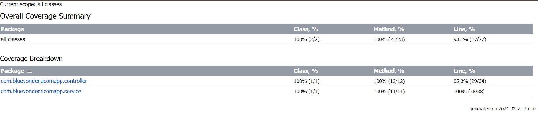
Product Service Test Report

Slide 12
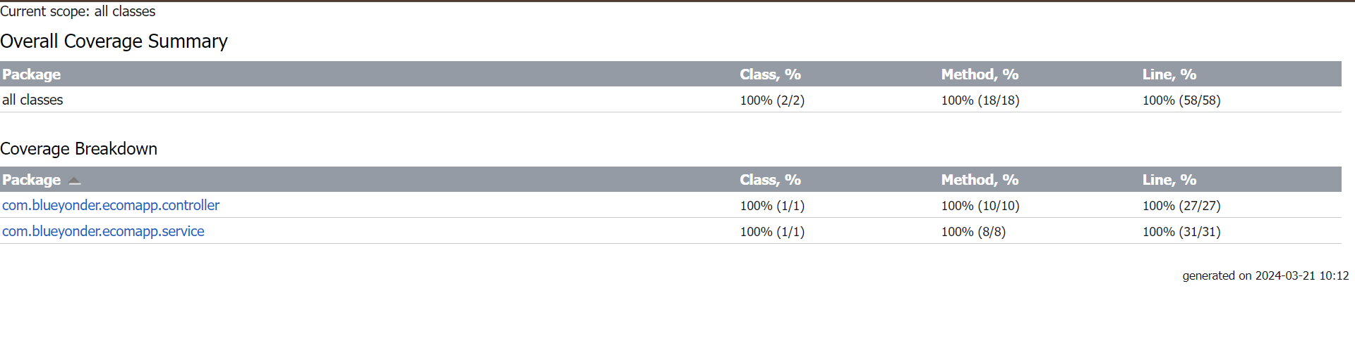
Category Service Test Report

Slide 13
features

Slide 14
Create Products
Edit Product
Link product to category
Delete Product
Search Products by Name
Cart
Create Category
Edit Category
Delete Category
Search category by name

Slide 15
Overview of ecomapp

Slide 16
Home page

Slide 17
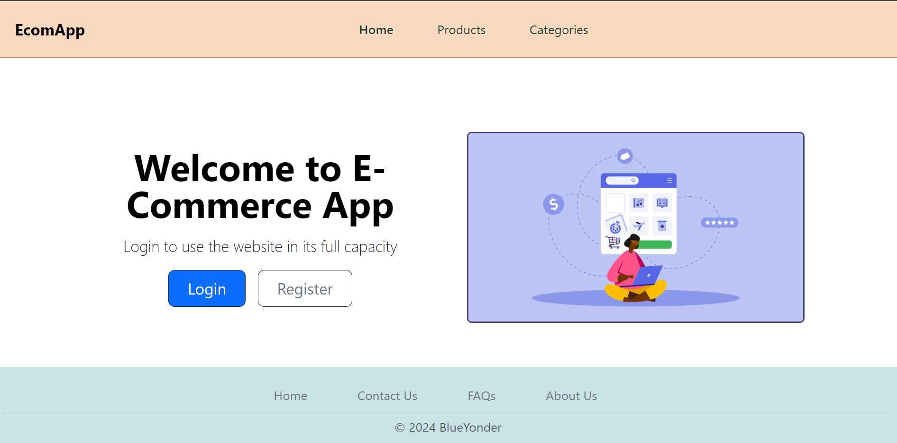

Slide 18
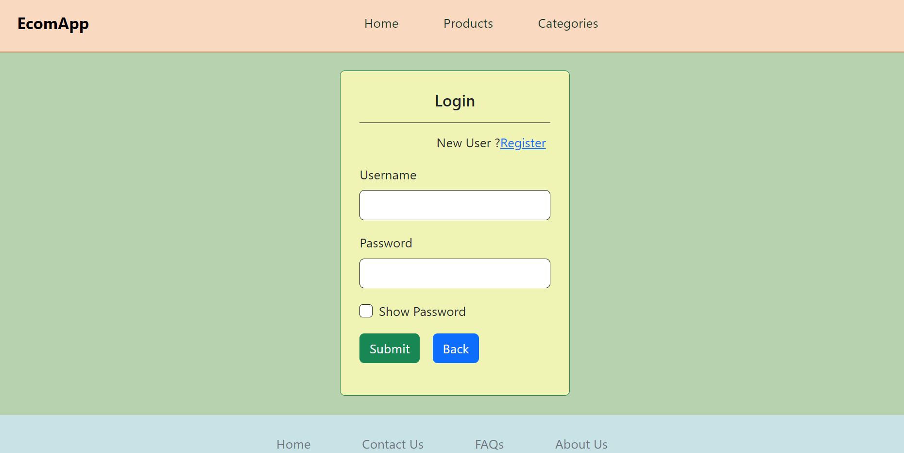
Login Page

Slide 19
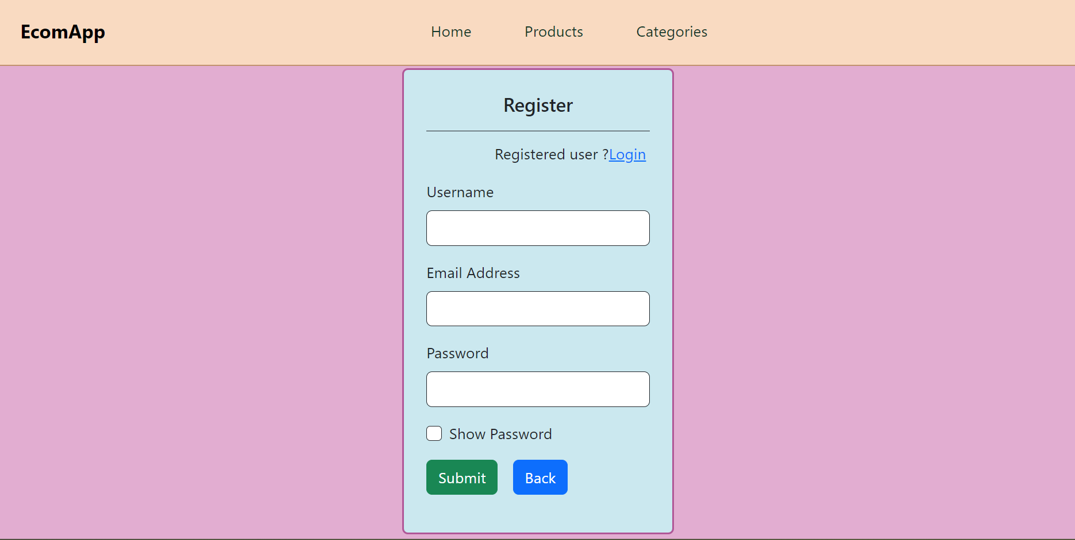
Register Page

Slide 20
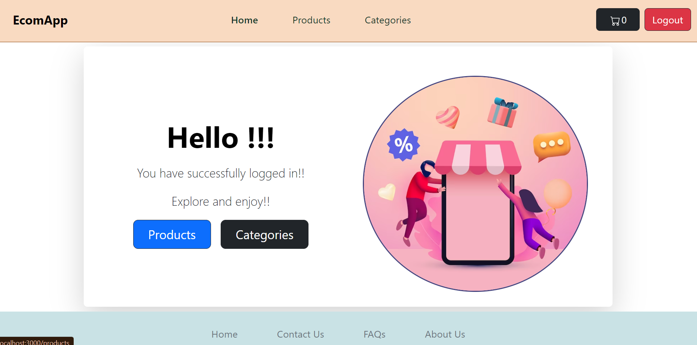
Home Page after Login

Slide 21
Products

Slide 22
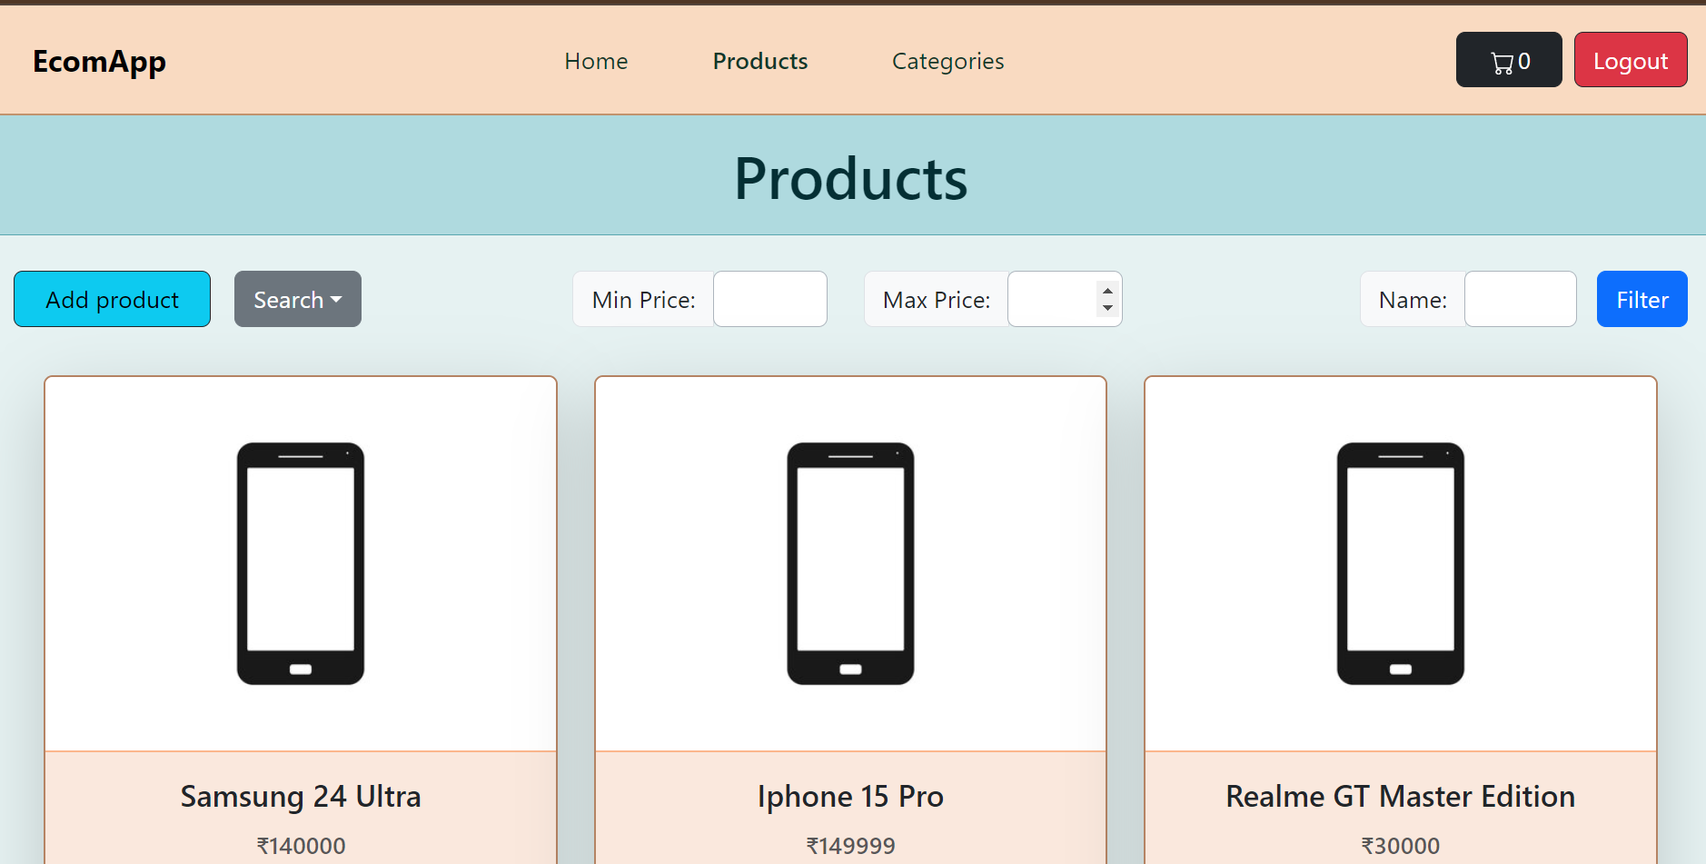
Products Page

Slide 23
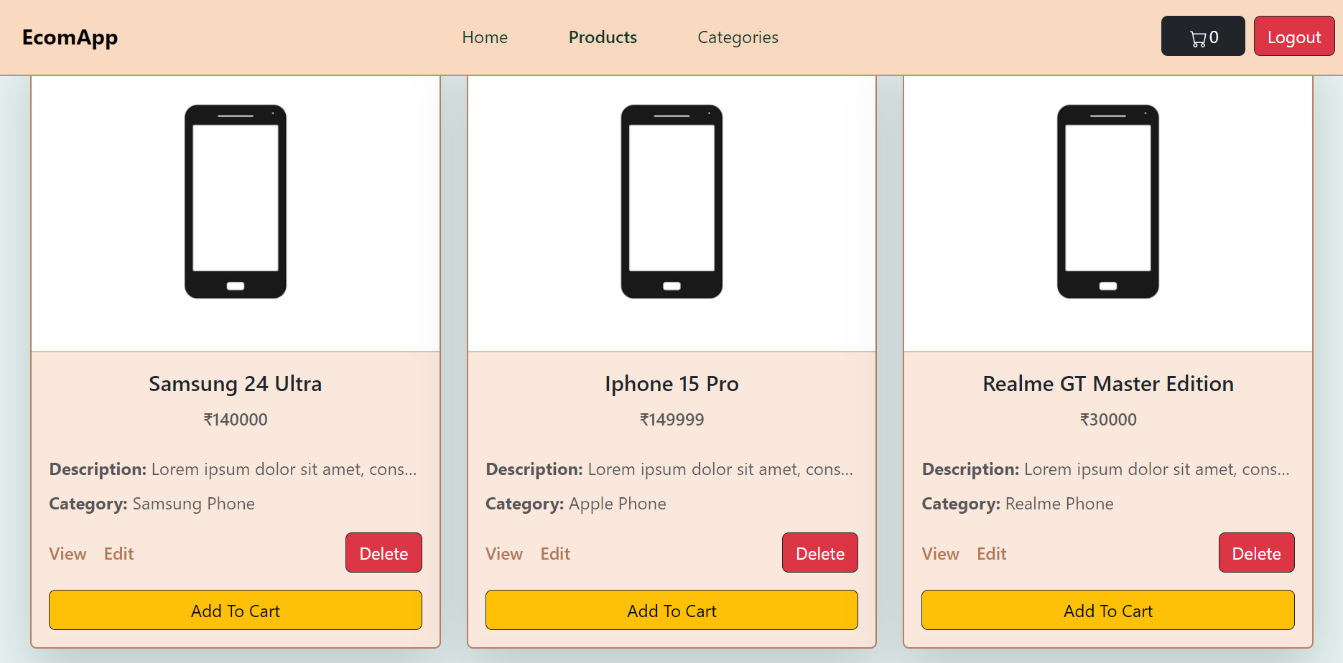
Cards in Products Page

Slide 24
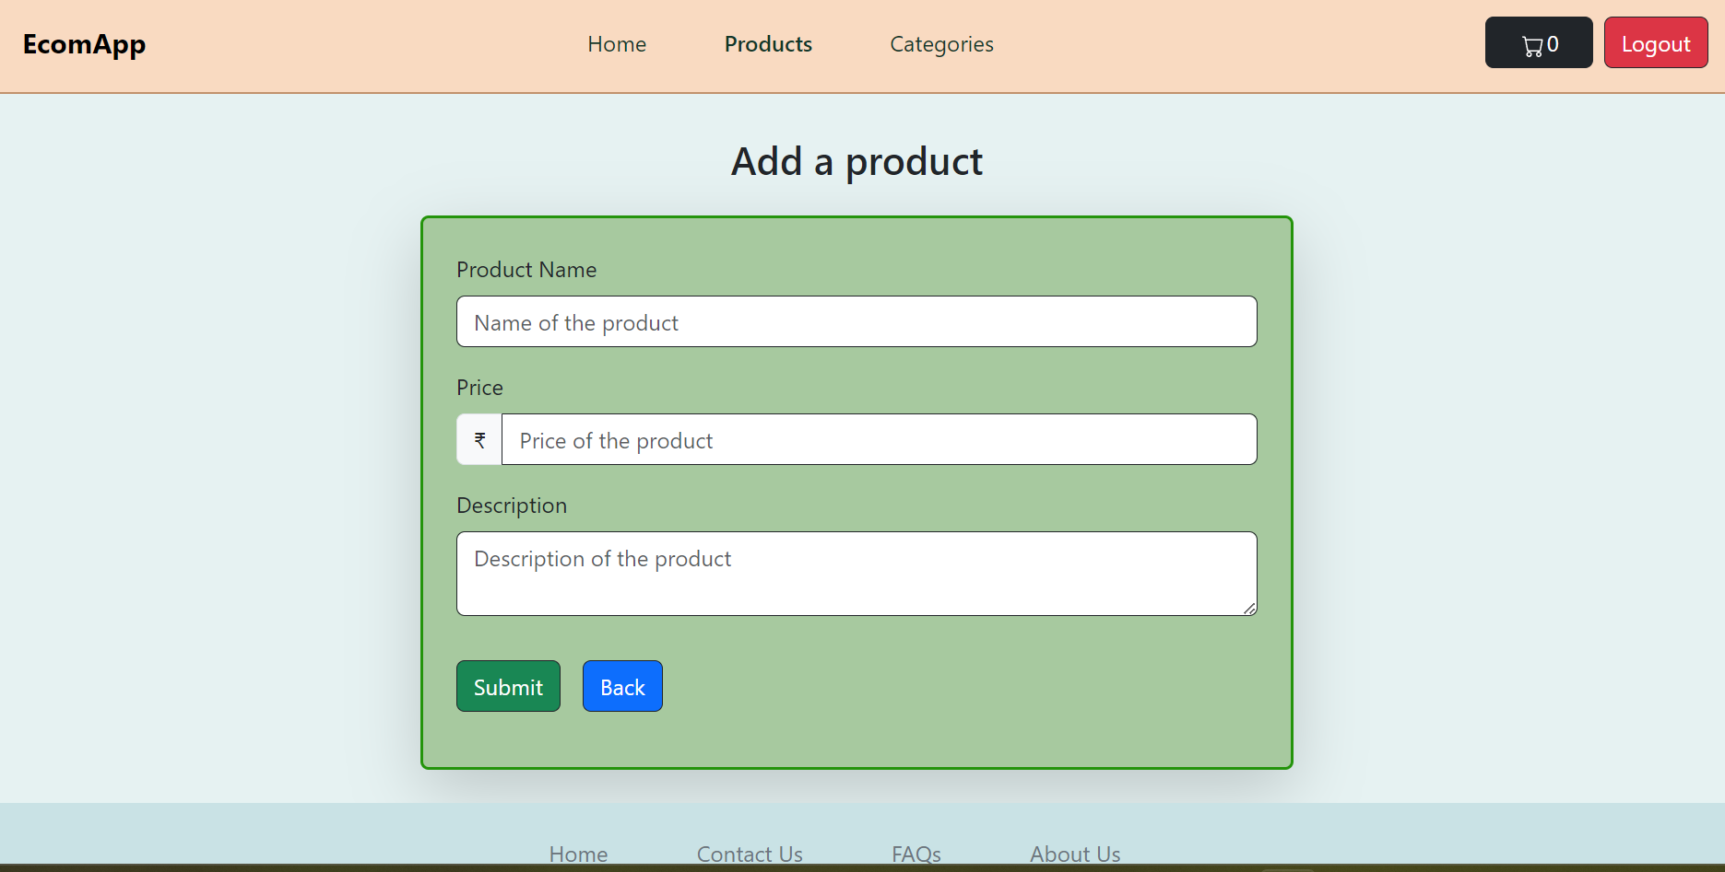
Add a product

Slide 25
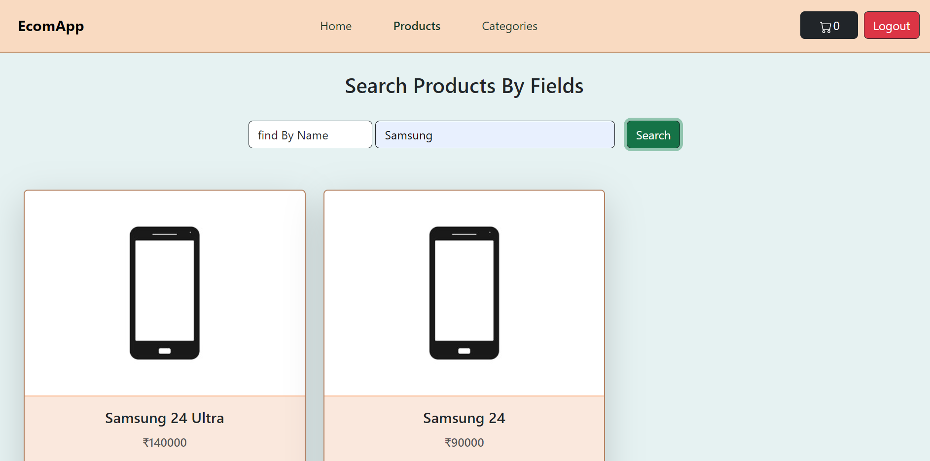
Search Products By fields

Slide 26
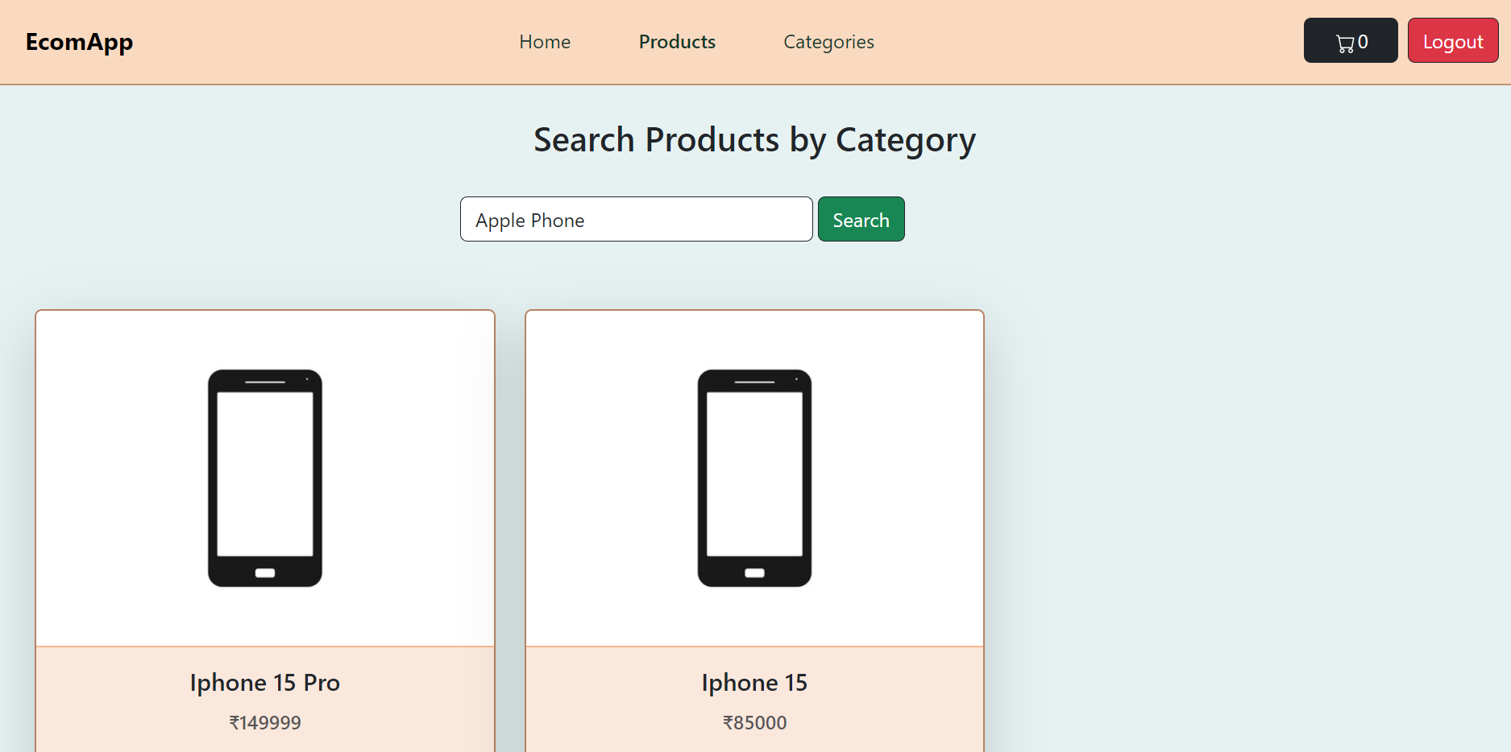
Search Products By Category

Slide 27
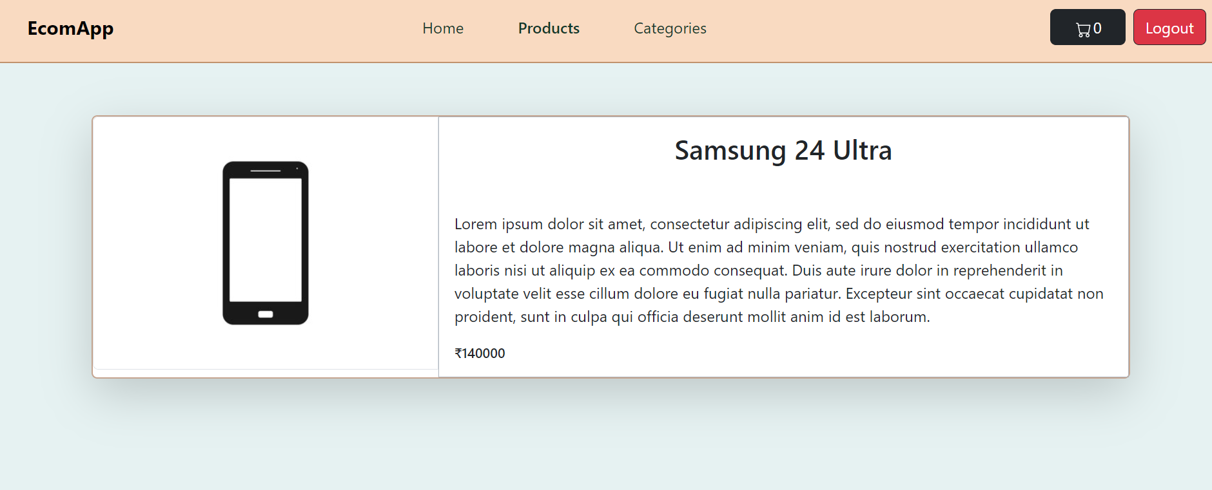
Product Detail

Slide 28
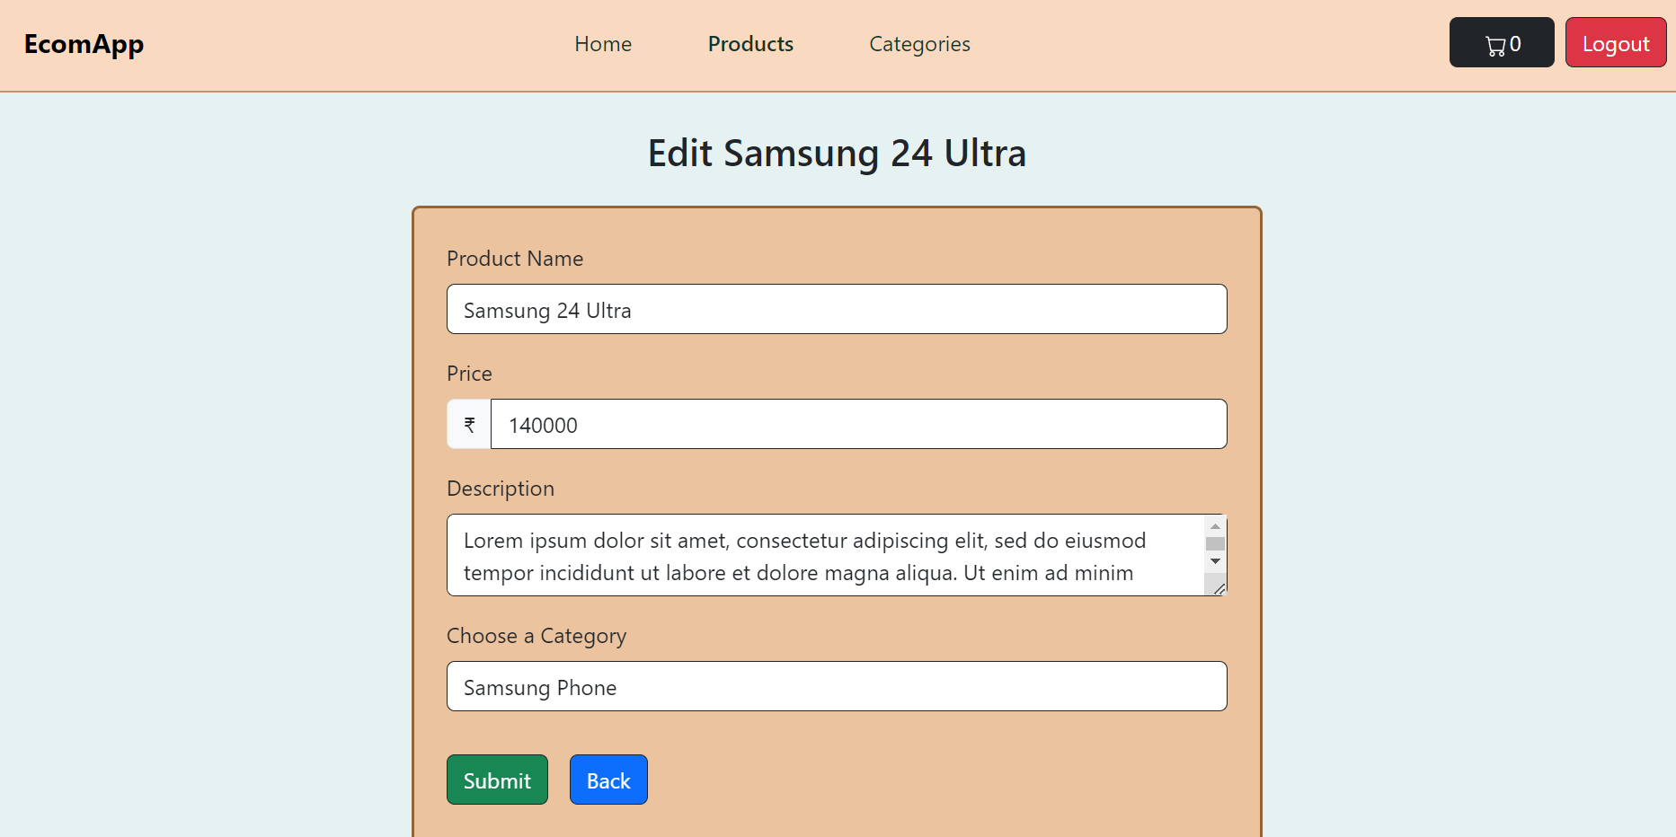
Edit Product

Slide 29
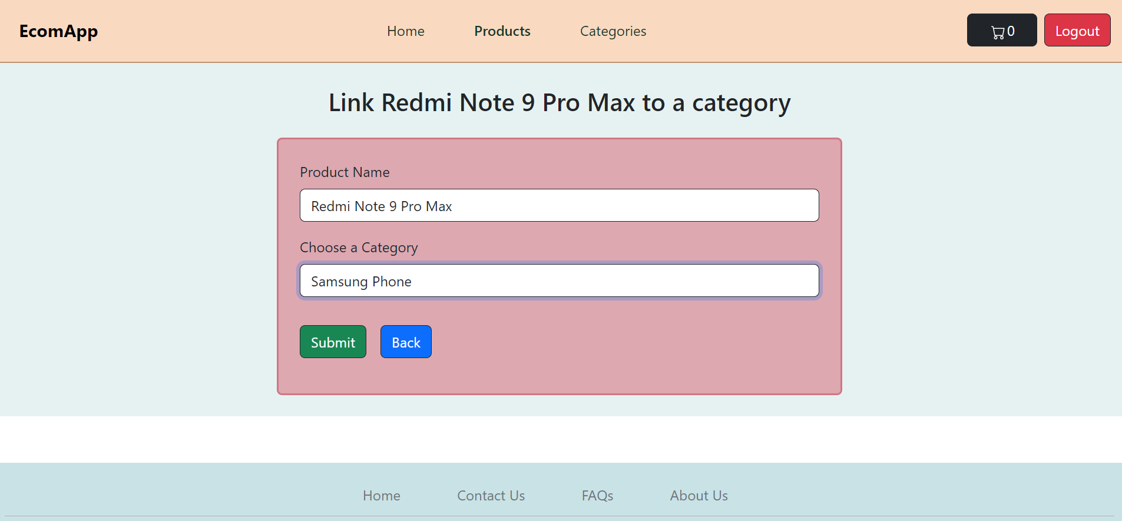
Link Product to a category

Slide 30
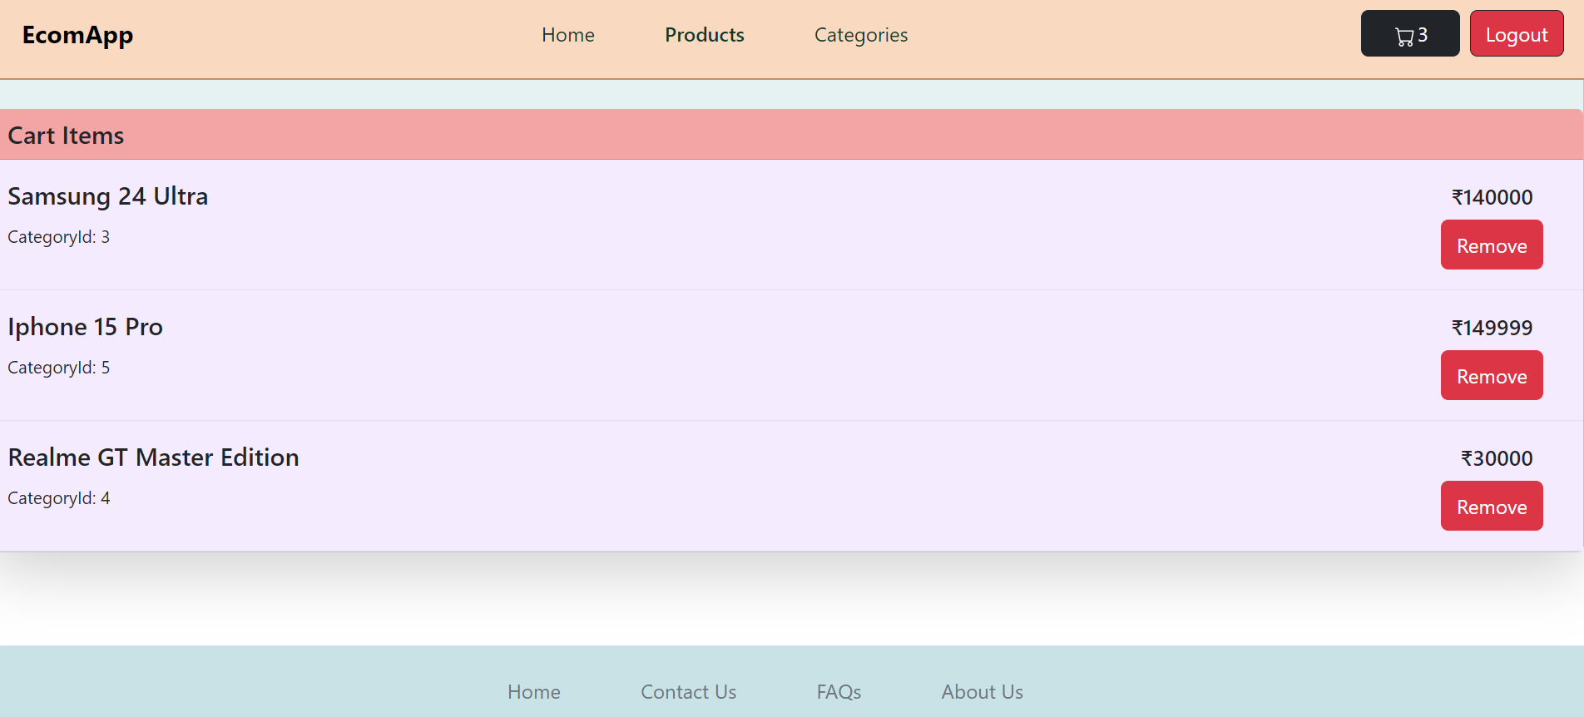
Cart

Slide 31
categories

Slide 32
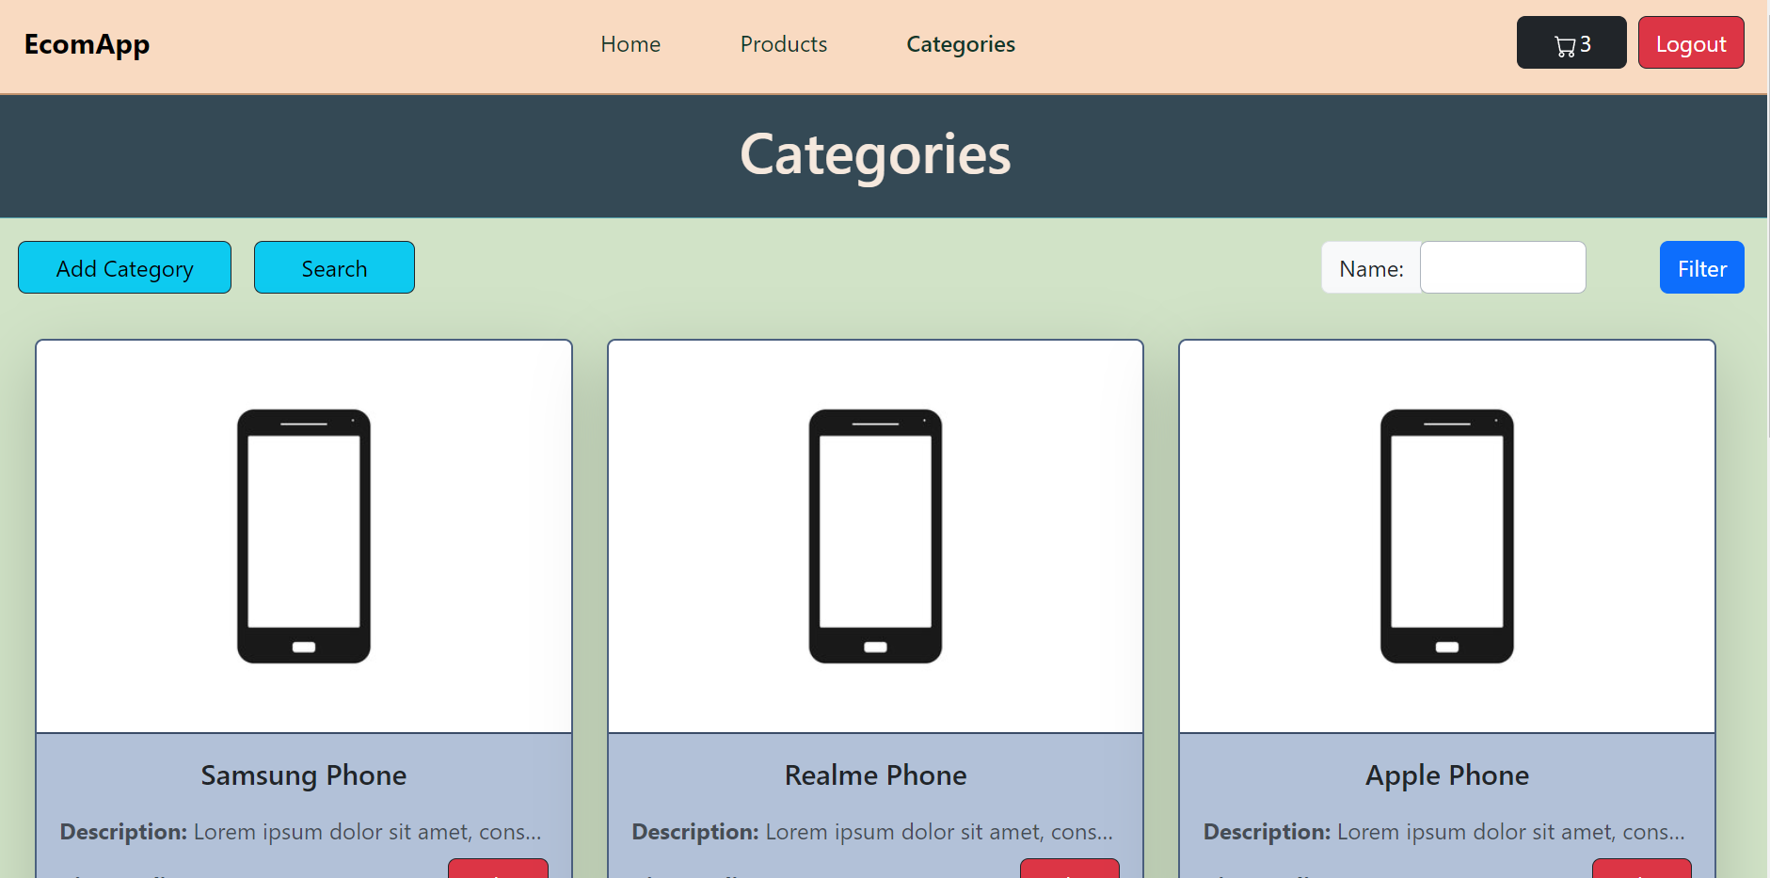
Categories Page

Slide 33
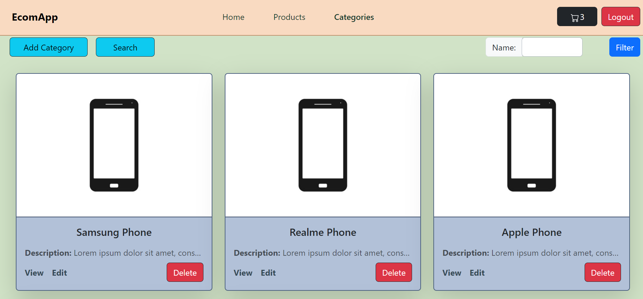
Categories Cards

Slide 34
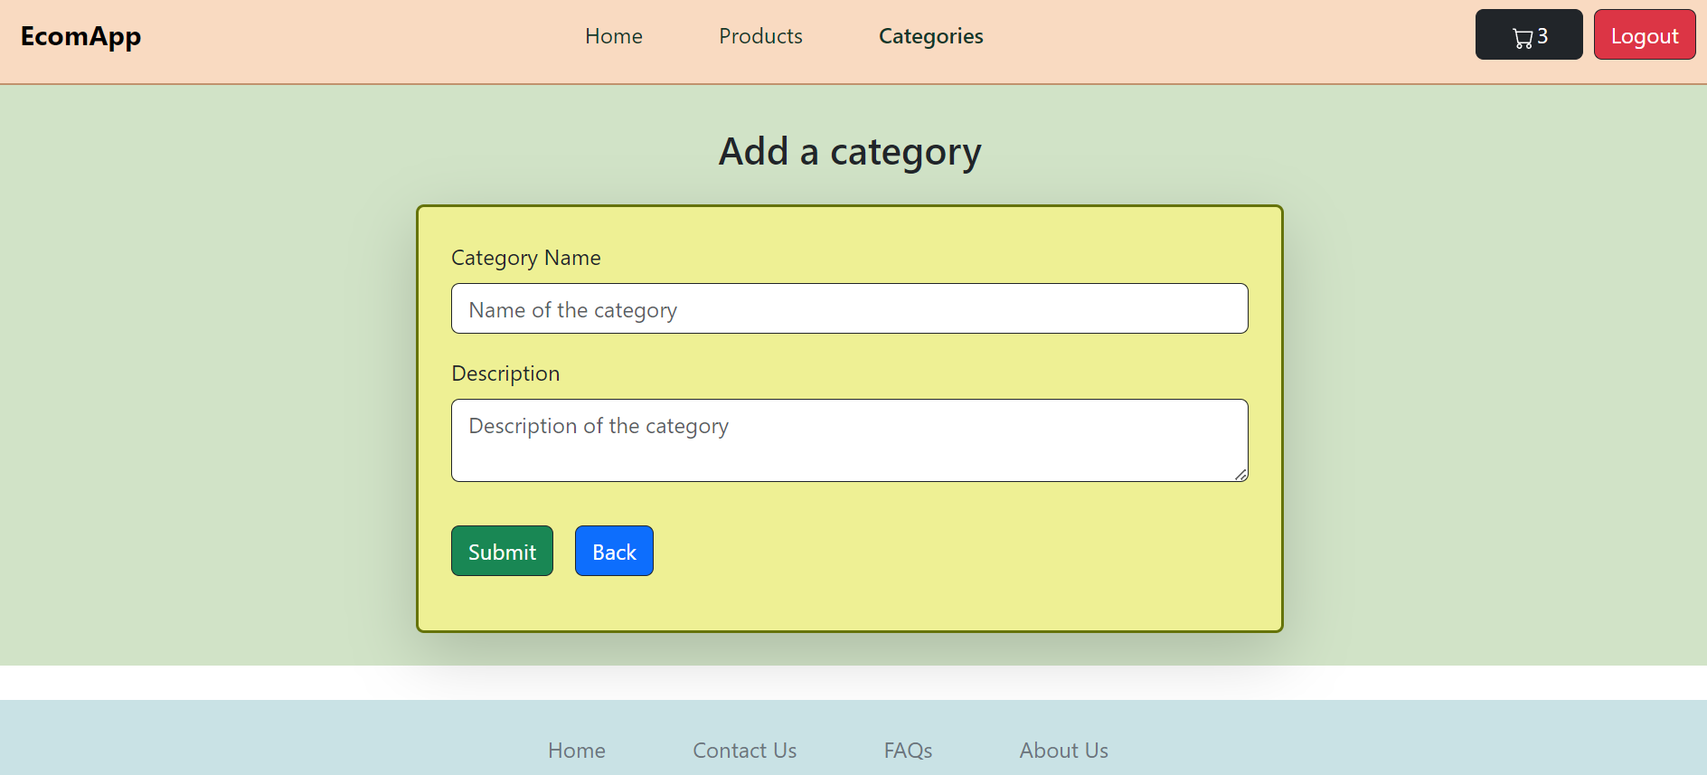
Add a category

Slide 35
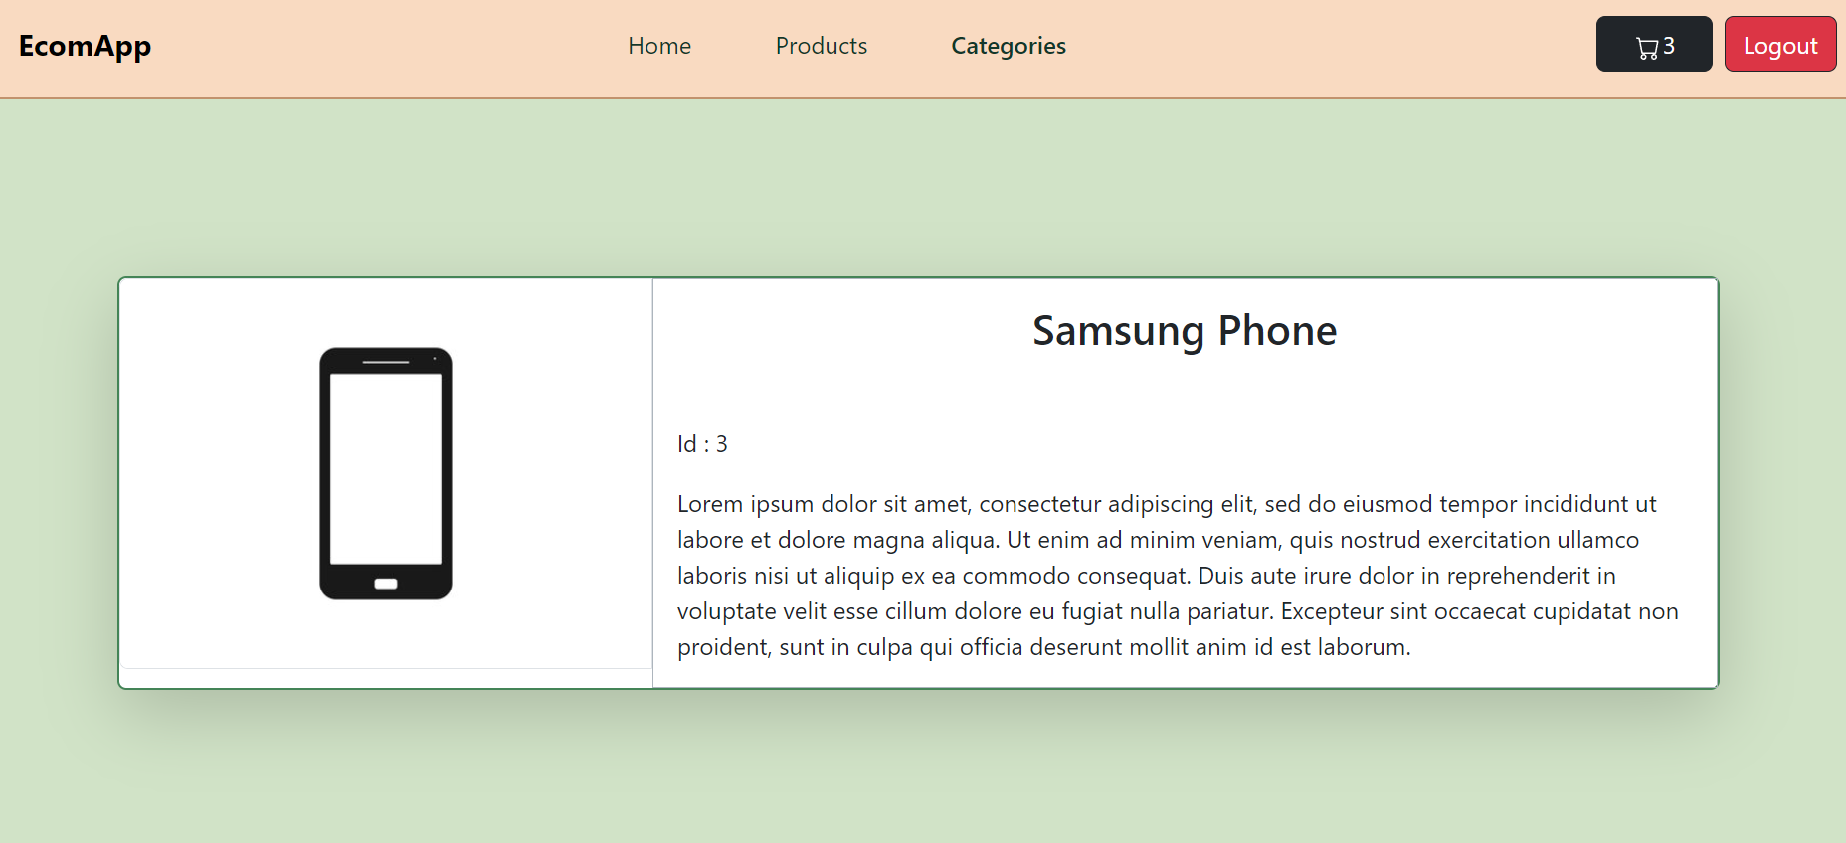
Category Detail

Slide 36
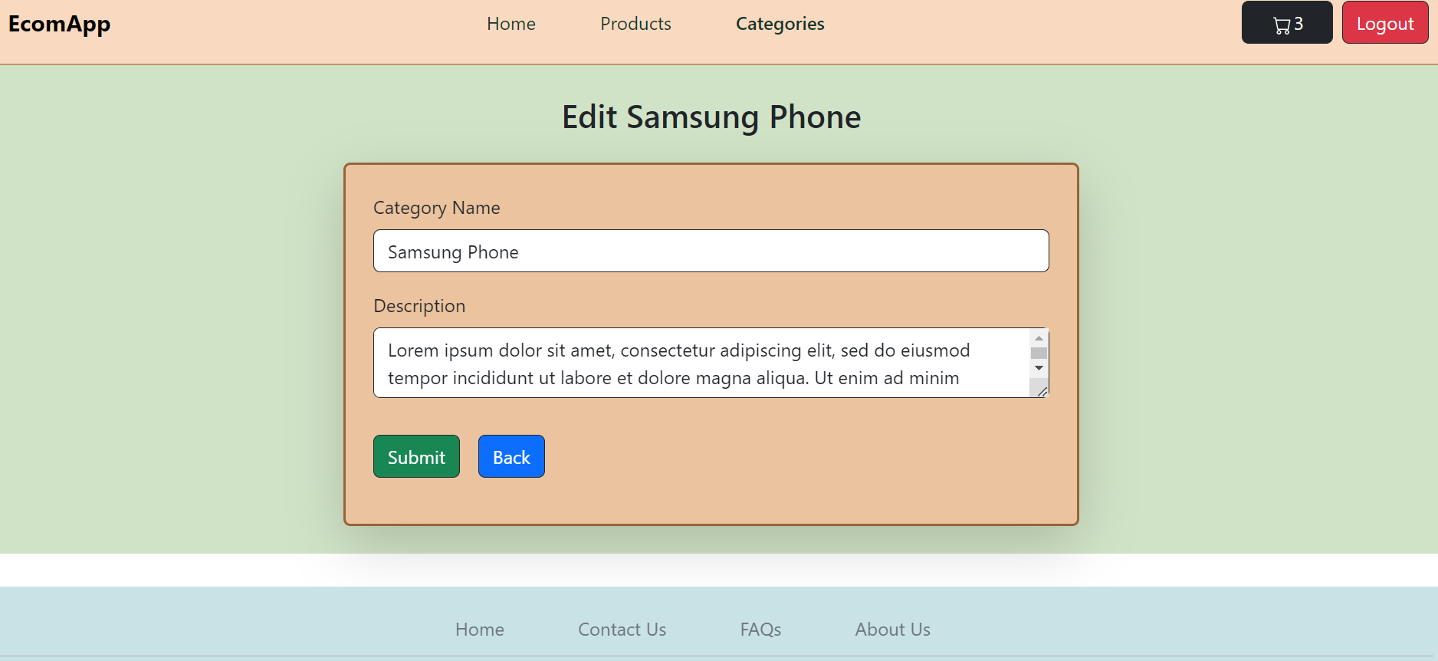
Edit Category

Slide 37
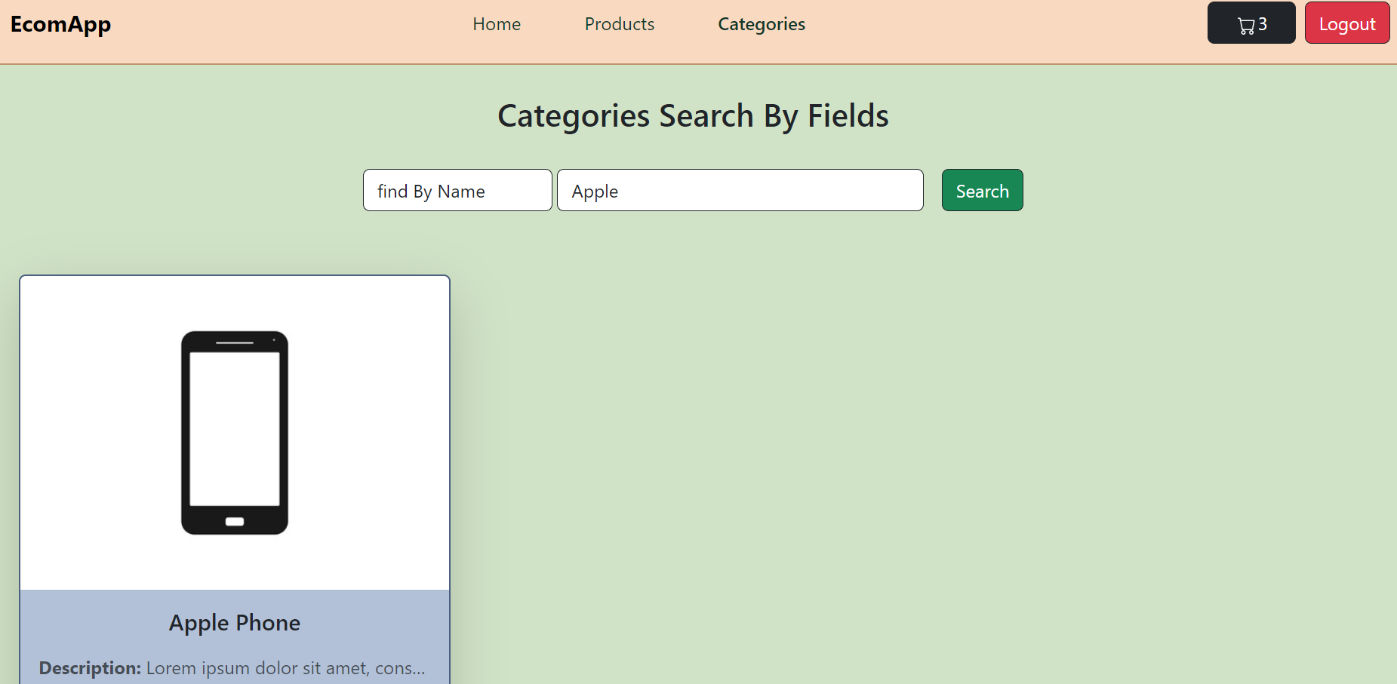
Search Categories By Fields

Slide 38
Future enhancements

Slide 39
Workflow in Git Hub Actions
Implement order management
Make it more reponsive
User Management

Slide 40
THANK YOU

